Slide 1
Chat Bot Helpdesk DTE FTUI
Muhammad Hamzah (1706043065)
Luthfi Rahman Hardy (1706042794)
Adri Ahmad an-Nabaa (1706043153)

Slide 2
Preliminary
Background
Formulation of Problem
Goals
Benefits

Slide 3
Background
The students didn’t have enough time or didn’t know the basic requirements before applying internships/thesis/academic leave.
Easy access to information about academic leave, internship and thesis in an interactive way.
There are at least one student who are too lazy to visit official website to find out the procedure

Slide 4
Formulation of Problem
How can chat bot answers all the user’s questions correctly?
How to make chat bot understand the procedure of internships, thesis, and academic leave?
What has to be done to bring the chat bot as a tool to overcome student’s problem about administration process of internships, thesis, and academic leave?
How to provide a chat bot in a good-looking way so the users can be more attracted to use/recommend this?

Slide 5
Purposes (Goals and Benefits)
The purpose of we made this project is to make the chat bot properly so that it can be implemented to help the problem in the campus environment and in the Software Engineering course project.
In the future, we hope chat bot can be more interactive

Slide 6
Requirement
Responsive chat bot web, just go to the link, no install
Chat bot can learn and be trained from the question from user
Can compare user input (for internship requirement)
Provide information about academic leave, internship, and thesis

Slide 7
Project Management
4P
Software Tools & Services
CMM
Unified Process Matrix

Slide 8
4P
People: Luthfi Rahman Hardy as the website designer, whereas Ahmad Adri an-Nabaa as the programmer for database for questions and answers.
Project: This program’s projects are creating the ChatBot that connected to Engati Platform via Internet that provides the users to get some information about the procedures in applying for academic leave, internship, and/or thesis.

Slide 9
4P
Process: Gathering the requirements and then implement them into the webpage and the chat bot engine
Product: ChatBot with an attractive design and improved quality in answering questions

Slide 10
Software Tools & Services
Code Editor : Notepad ++
Framework : Bootstrap
Services : Engati (chat bot), 000webhost (hosting)

Slide 11
CMM Level
Level 2 (Repeatable)
Manage the requirement: to answer every user’s question as accurate as possible
Estimated cost until the end: 0
Current progress: 35% of total progress
Software standard: question handling capability = 95% of questions

Slide 12
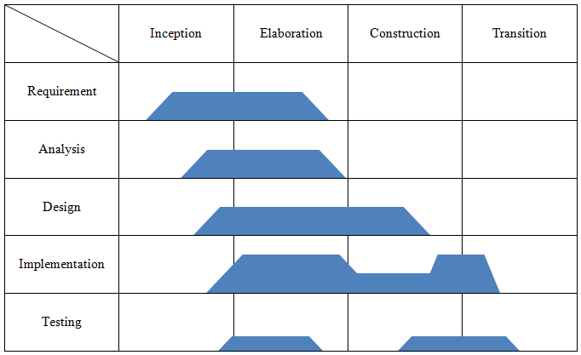
Unified Process Matrix

Slide 13
Design and Analysis
UML Diagram
Mock-Up Design

Slide 14
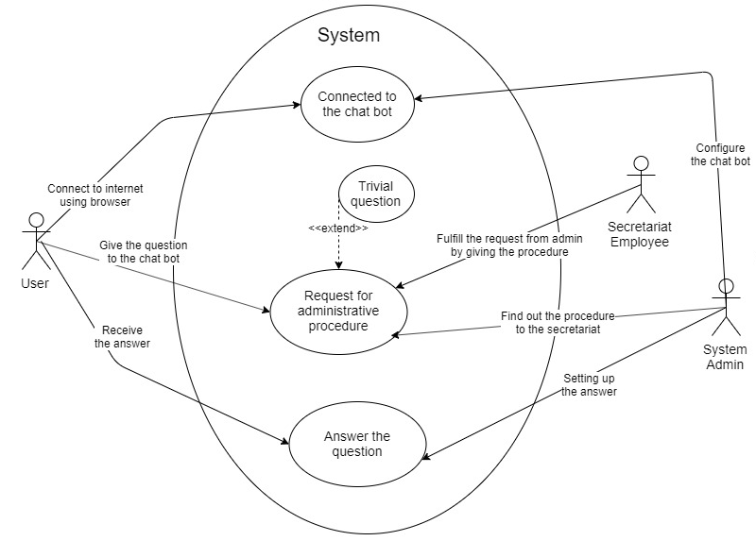
UML Diagram
Use Case Diagram

Slide 15
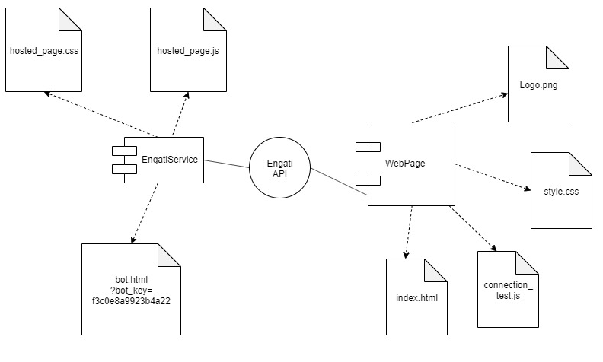
UML Diagram
Component
Diagram

Slide 16
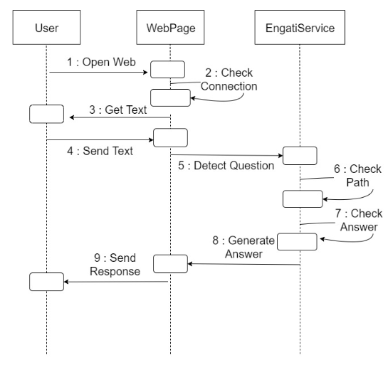
UML Diagram
Sequence
Diagram

Slide 17
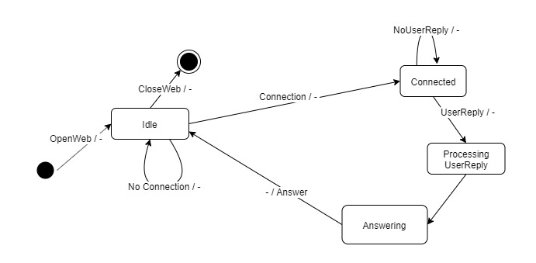
UML Diagram
State Transition
Diagram

Slide 18
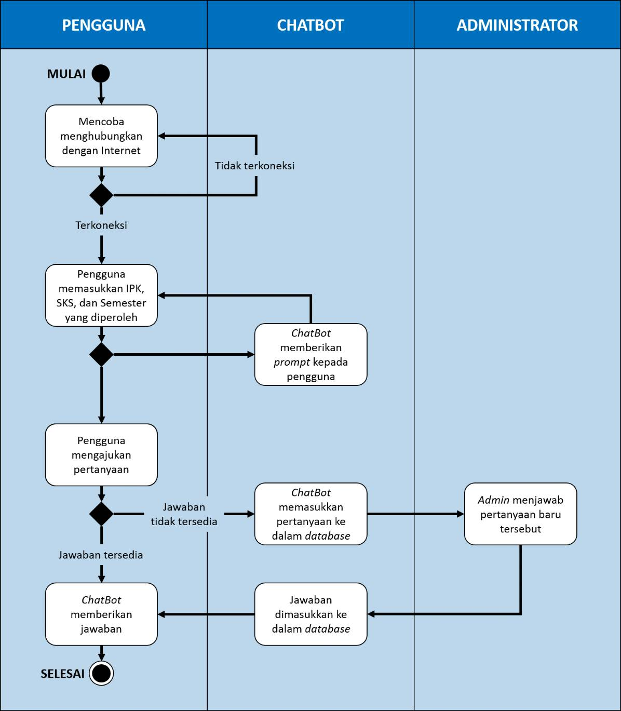
UML Diagram
Activity
Diagram

Slide 19
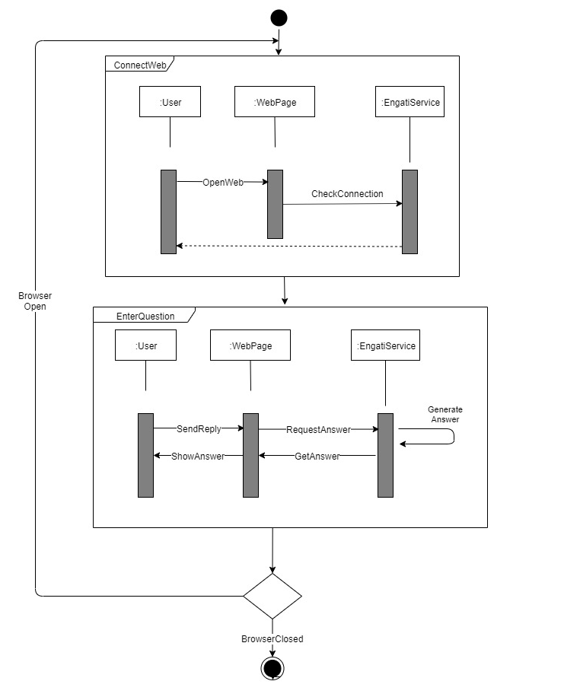
UML Diagram
Interaction
Overview
Diagram

Slide 20
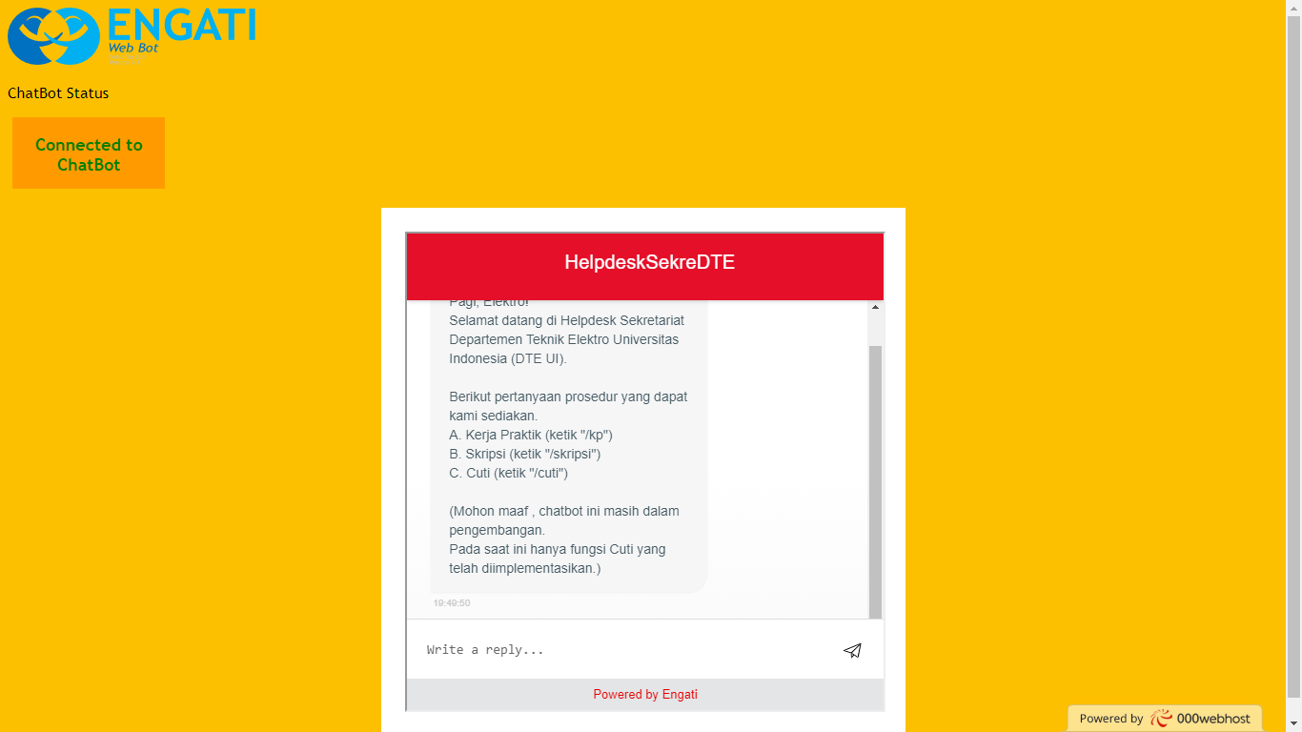
Mock-Up Design

Slide 21
Code Implementation
Code for Webpage
Code for Engati Service

Slide 22
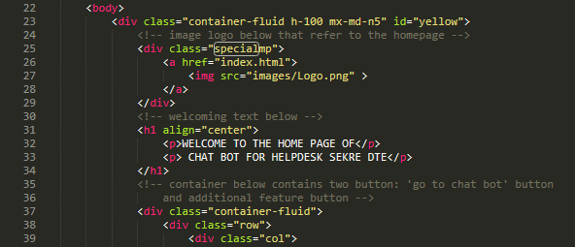
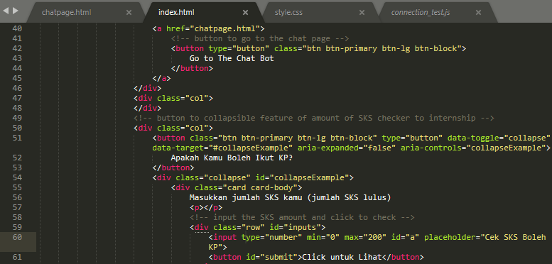
Code for Webpage
index.html

Slide 23
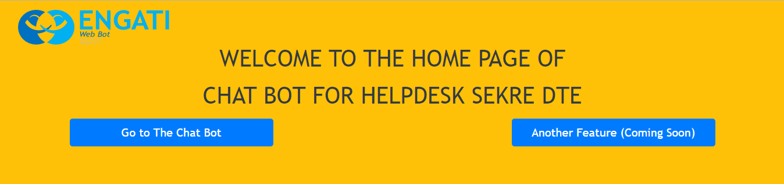
Display of Code’s Output
index.html

Slide 24
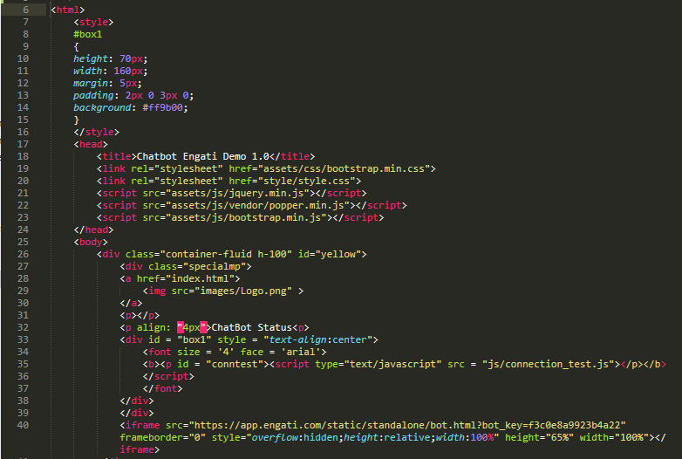
Code for Webpage
chatpage.html

Slide 25
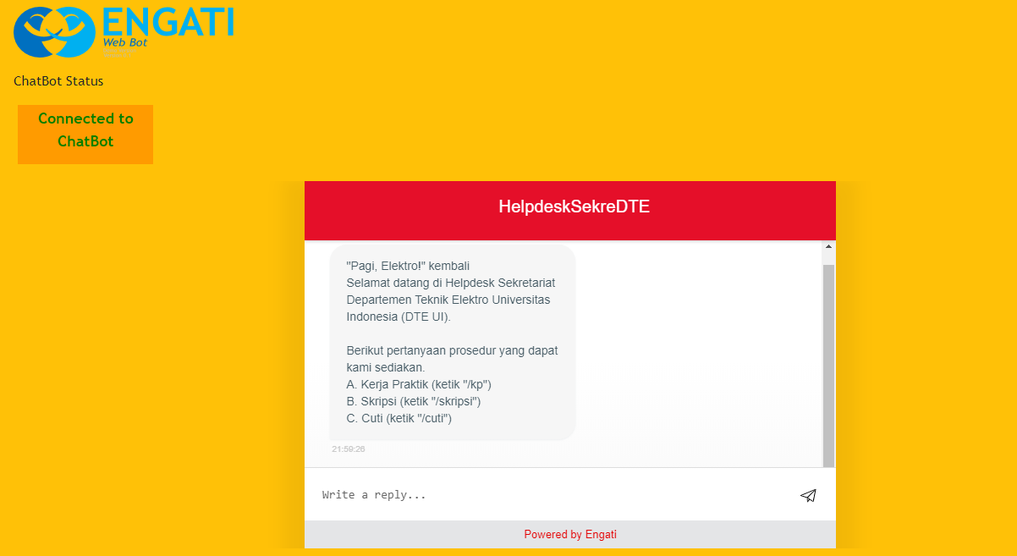
Display of Code’s Output
chatpage.html

Slide 26
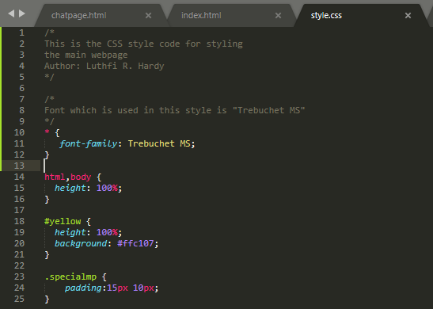
Code for Webpage
style.css

Slide 27
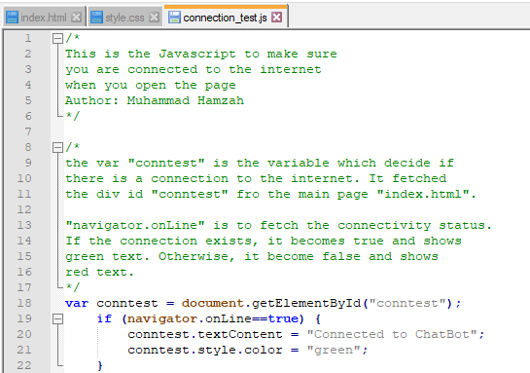
Code for Webpage
connection_test.js

Slide 28
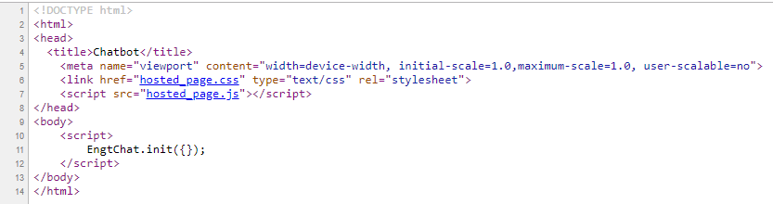
Code for Engati Service
bot.html

Slide 29
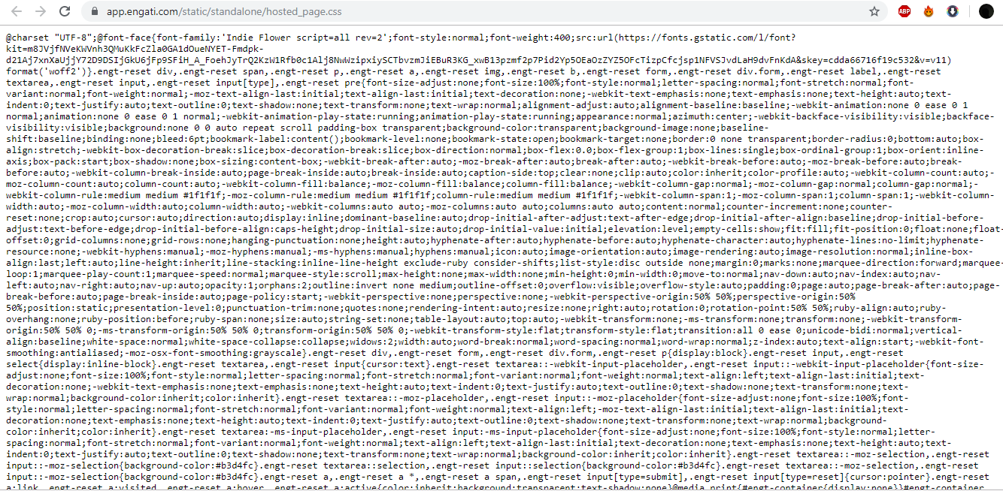
Code for Engati Service
hosted_page.css

Slide 30
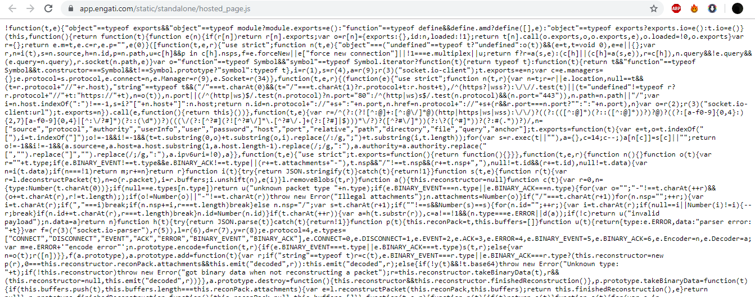
Code for Engati Service
hosted_page.js

Slide 31
Unit Testing
Normal Parameter
Limit Parameter
Outside Parameter

Slide 32
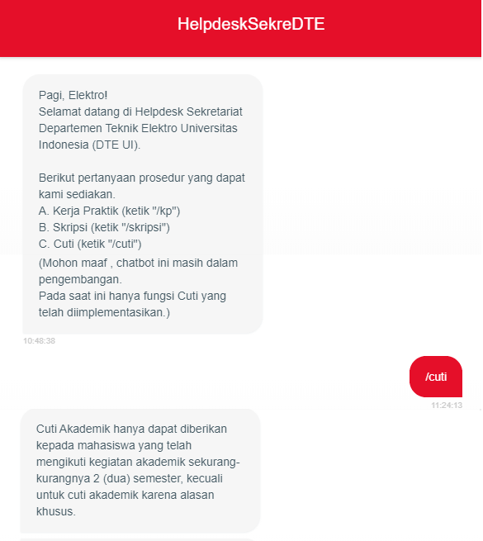
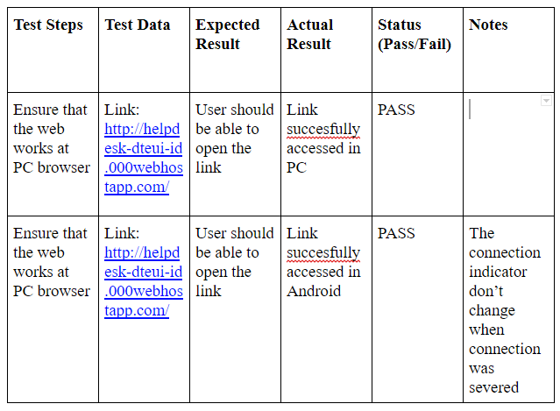
Unit Testing
Normal Parameter
Compatibility Test

Slide 33
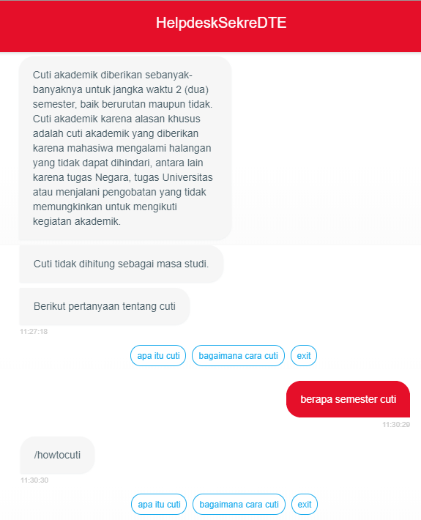
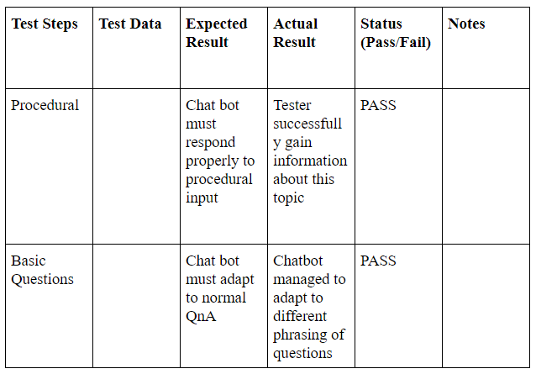
Unit Testing
Limit Parameter
Functional Test – Academic Leave

Slide 34
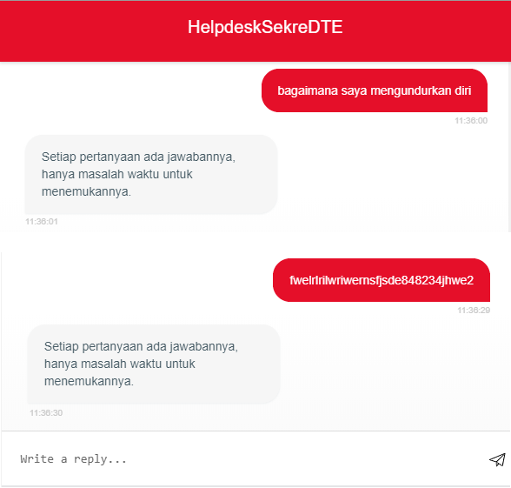
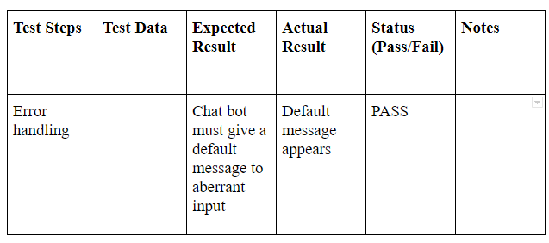
Unit Testing
Outside Parameter
Functional Test – Error Handling

